Slide 1
Navigating the Academic Job Market
Sara Reed and Xiexin Liu
INFORMS Knowledge Café

Slide 2
Sara Reed
PhD Candidate in Applied Mathematical and Computational Sciences (AMCS)
Advisors: Ann Campbell and Barry Thomas
Dissertation: Value of Autonomous Vehicles in Last-Mile Delivery
Fall 2021: Assistant Professor of Business Analytics at the University of Kansas School of Business

Slide 3
Estimated Timeline for Sara Reed
Prepared materials in Summer 2020
Asked letter writers in August 2020
Started submitting applications in October 2020
First-round interviews started in early December 2020
Second-round interviews started in late December 2020
Accepted position in February 2021

Slide 4
Xiexin Liu
PhD Candidate in Business Analytics
Advisors: Johannes Ledolter
Fall 2021: Visiting Assistant Professor of Data Analytics at Dickinson College

Slide 5
Estimated Timeline for Xiexin Liu
Submitting applications: November 2020 – January 2021
First-round interviews: November 2020 – March 2021
Second-round interviews: December 2020 – March 2021
Accepted position in early March
First-round interviews can still happen in March, and schools might not make a decision until late April.

Slide 6
Where to begin?

Slide 7
What type of position do you want?
These positions are not listed in a particular order.
Post-doc
Lecturer
Tenure-track position at teaching school
Tenure-track position at research institution

Slide 8
Find letter writers
Need 3-5 letter writers.
Most applications ask for 3.
At least one letter writer should be able to speak to your teaching.

Slide 9
Prepare materials
CV
Research Statement
Teaching Statement + Teaching Evaluations
Diversity Statement
Cover Letter
Transcripts
Job Market Paper(s)
Website

Slide 10
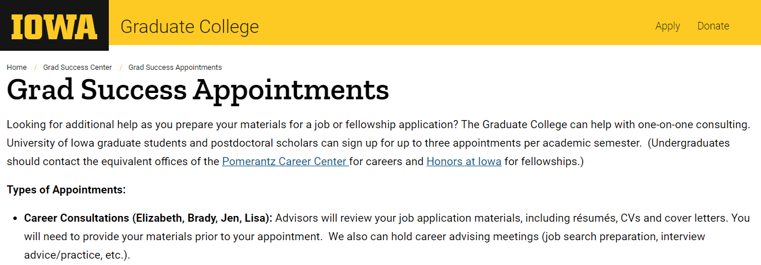
Graduate College Career Consultations
Receive feedback on application materials.
https://grad.uiowa.edu/grad-success-appointments

Slide 11
Where to find jobs

Slide 12
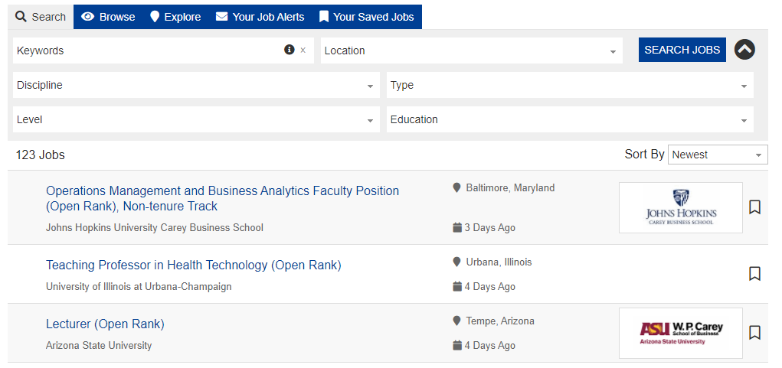
INFORMS Career Center
https://careercenter.informs.org/jobs/

Slide 13
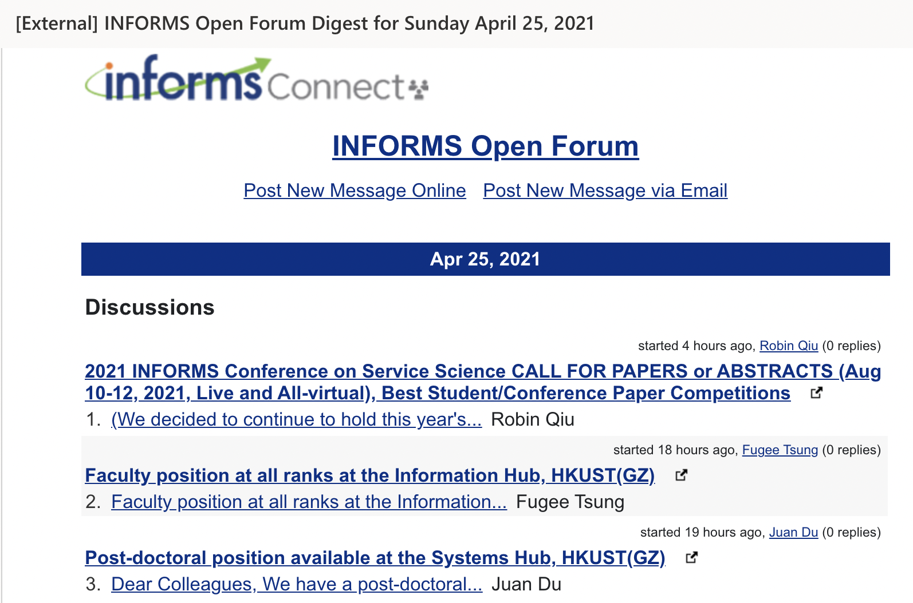
INFORMS Open Forum
https://connect.informs.org/
Sign up for the communities
you are interested in.
Receive email on new
postings in the forum daily.

Slide 14
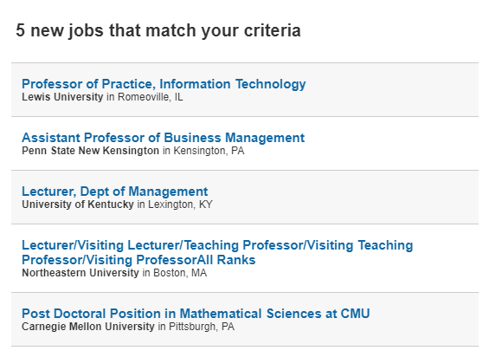
Higher Ed Jobs
https://www.higheredjobs.com/
Set up email notifications for job postings in your area

Slide 15
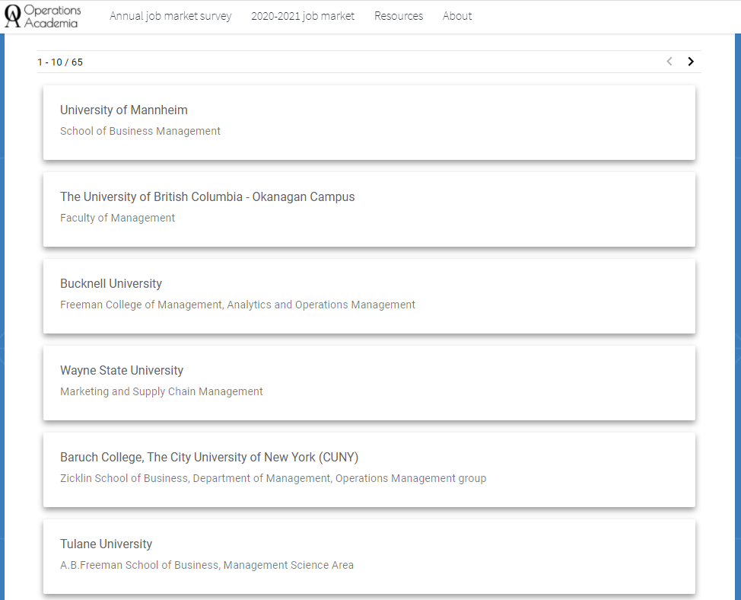
OperationsAcademia.org
Post your profile as a job market candidate.
Find job postings in Operations Research.

Slide 16
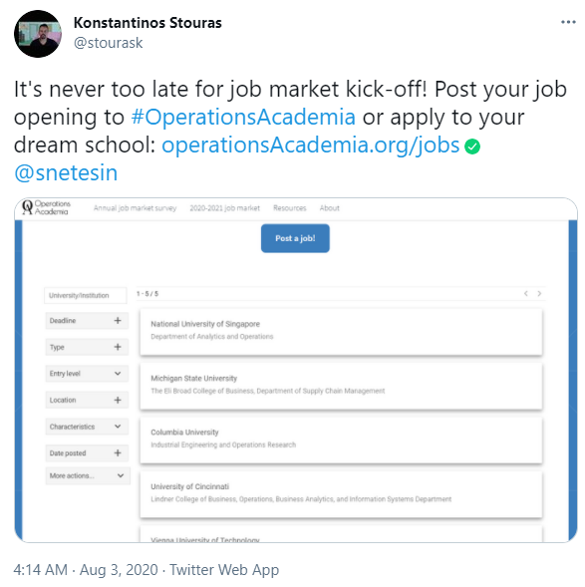
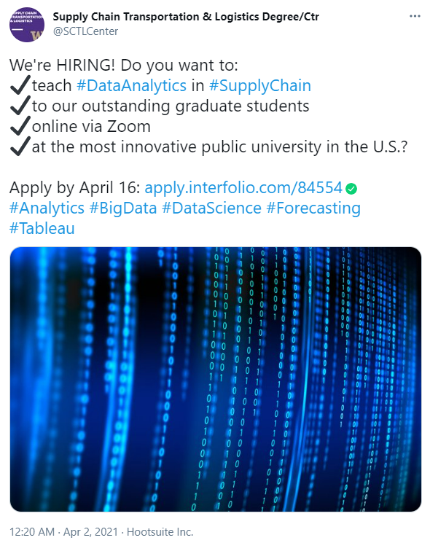
Twitter

Slide 17
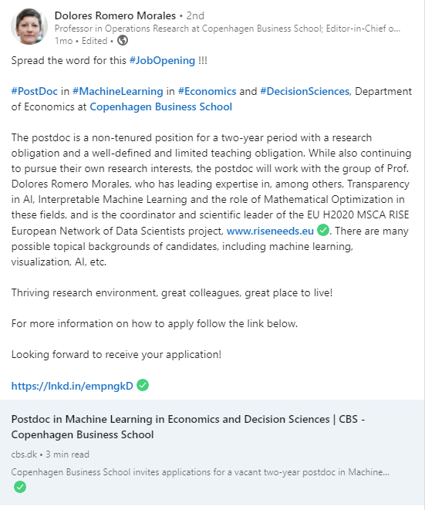
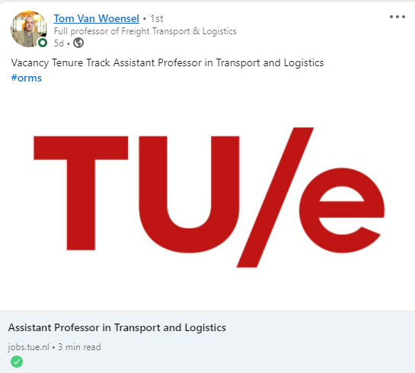
LinkedIn

Slide 18
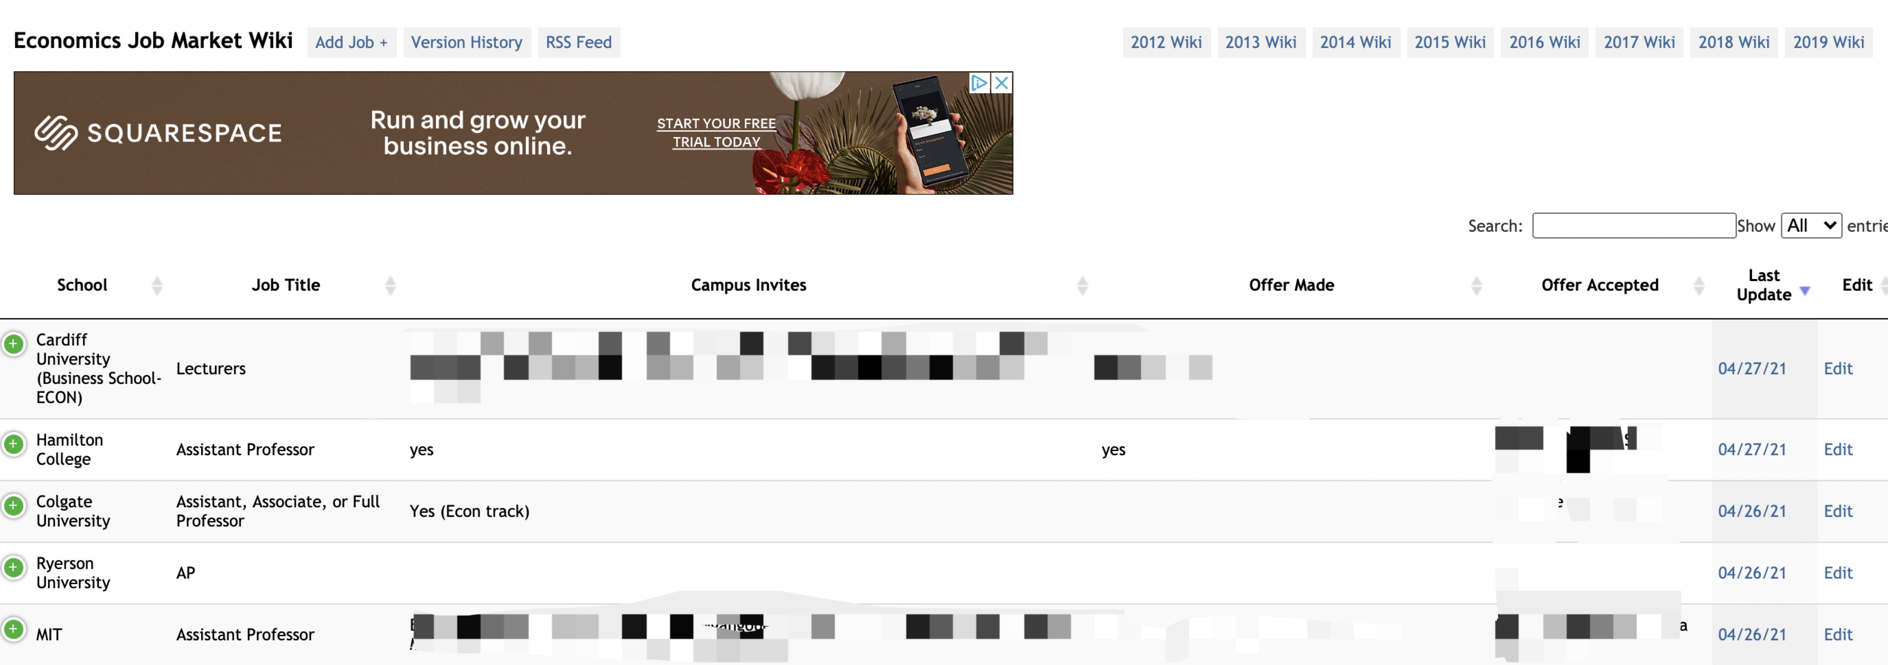
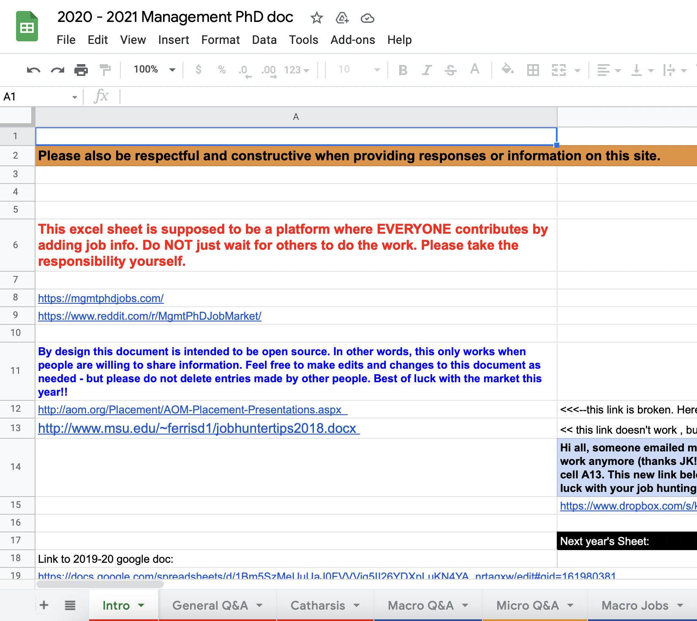
Miscellaneous
Simply Google “subject - title - area”
e.g., Analytics Assistant Professor Iowa
Depending on your area, you might find sources in Economics, Management, Marketing, Accounting, Statistics useful.

Slide 19
Things to consider if you have at least a year before the job market

Slide 20
INFORMS
Chair a session at an annual INFORMS meeting.
Attend the Doctoral Student Colloquium prior to INFORMS meeting.
Submit a presentation for a workshop in your area.
Consider a leadership position in the INFORMS Iowa Student Chapter.

Slide 21
College Teaching Certificate

Slide 22
Other Suggestions
Build your network.
Conferences
Twitter
LinkedIn
Become a head TA.
Draft application materials now to determine your strengths/weaknesses.

Slide 23
Thank you Xiexin Liu Sara Reed

